Slide 1


Unit 1B: Questions
English (Elementary, A1)
Oliver Castellanos Master in TEFL

Slide 2
Agenda 🗓️
Review: BE Vocabulary: Tricky words 🧐 Vocabulary II: World 🌍
Vocabulary III: Car hiring 🚗
Reading: On the phone 📱
Survey

Slide 3
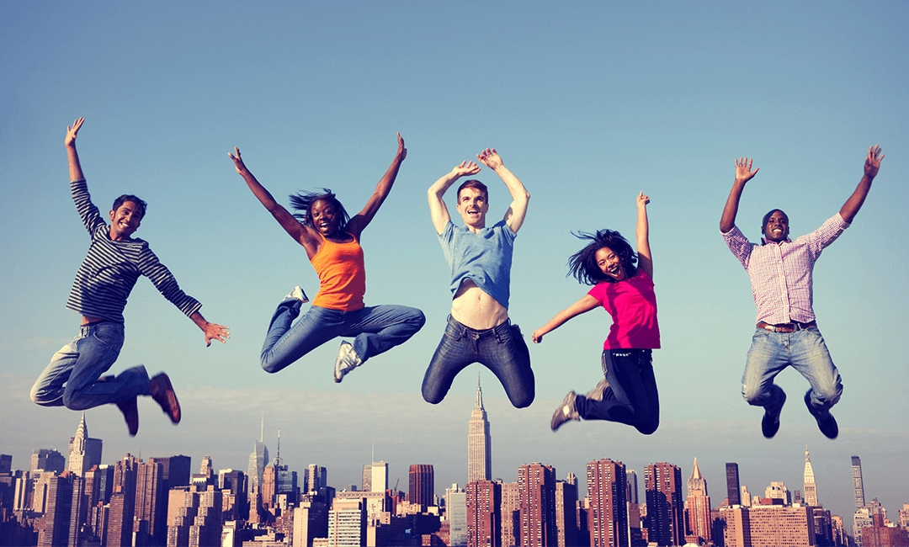
Learning objectives 📚
The student will be able to ask questions, using the verb to BE. The student will be able to answer questions, using the verb to BE.

Slide 4
Tricky words 🧐
Chips
Chocolate
Lunch
What’s your favorite chocolate? 🍫😋
What chips are delicious? 🍟🤤
What’s your favorite food? 🥑 🍲

Slide 5
Tricky words II 🧐
Chin
Beach
What’s your favorite beach? 🏖️
What is chin? 🤔

Slide 6
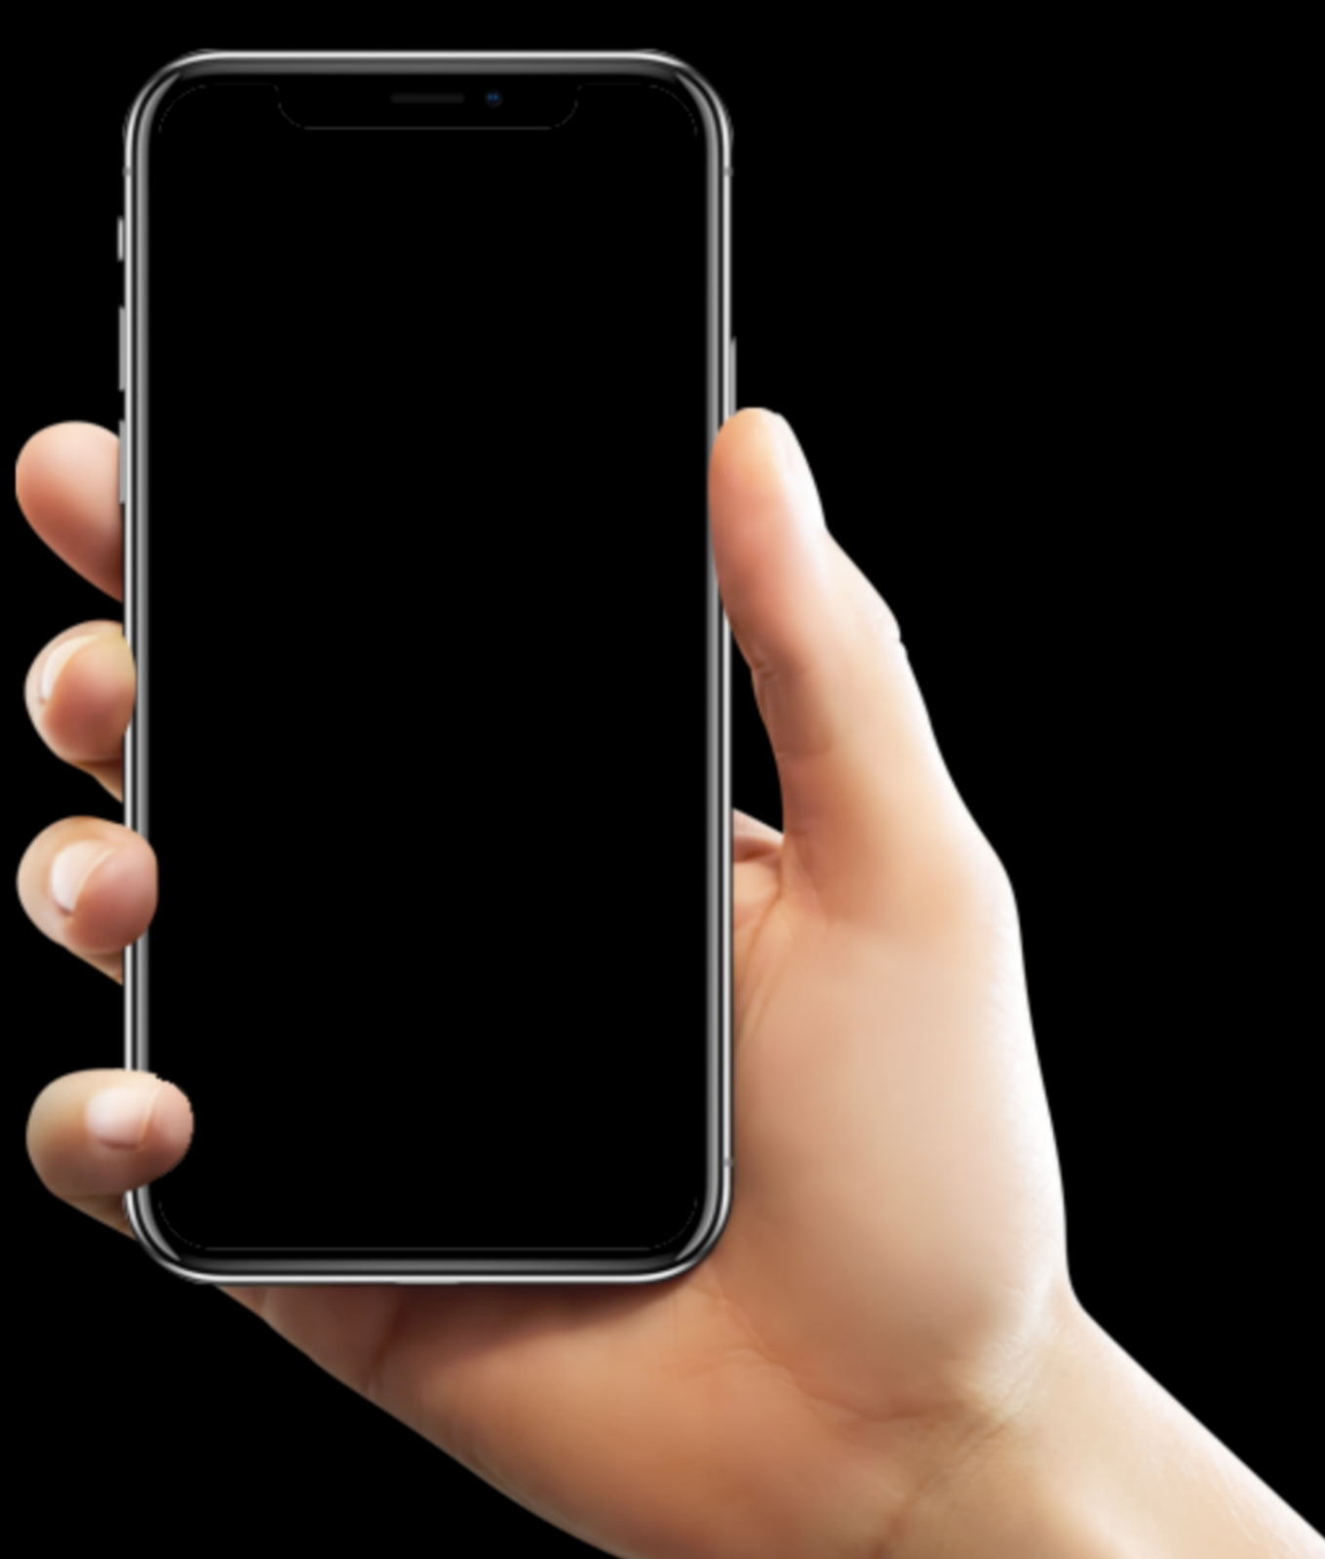
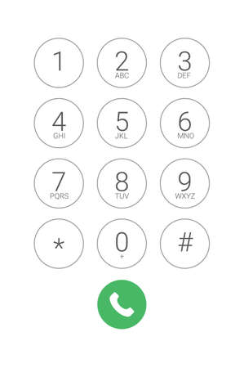
Numbers 0 – 9 📞
Zero One Two Three Four Five Six
Seven Eight
Nine
Tip! Zero = Oh!
7️⃣7️⃣ Double seven or 🎰 Triple seven

Slide 7

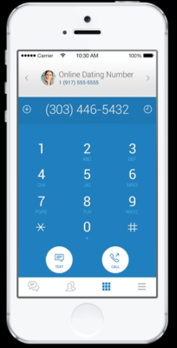
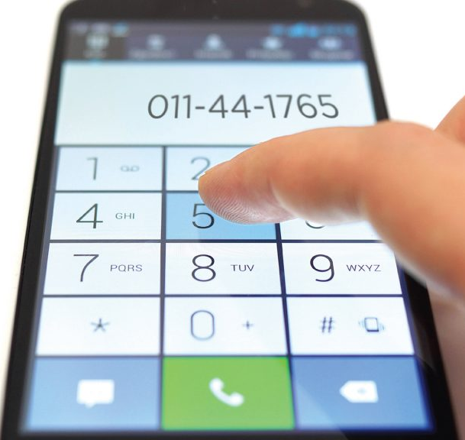
Comprehension task 🤓
How do you say these numbers?

Slide 8
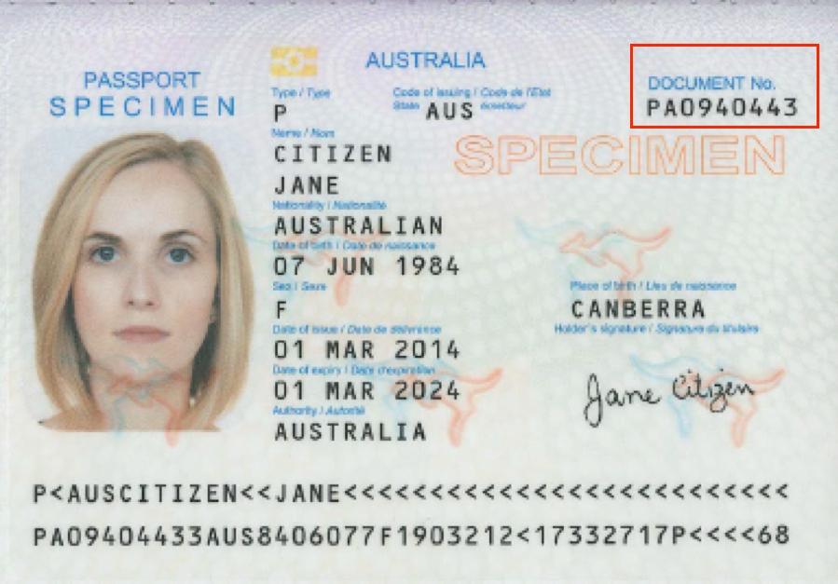
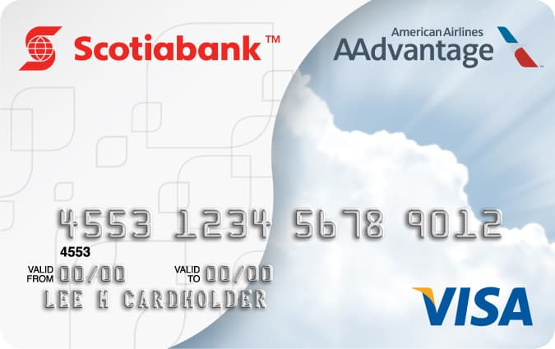

Comprehension task 🤓
What’s this in English?
Passport 🛂
Credit card 💳
Business Card 👨‍💼

Slide 9
Vocabulary: Personal details 😎
Address
Postcode
Home phone
Mobile phone
Car hiring

Slide 10
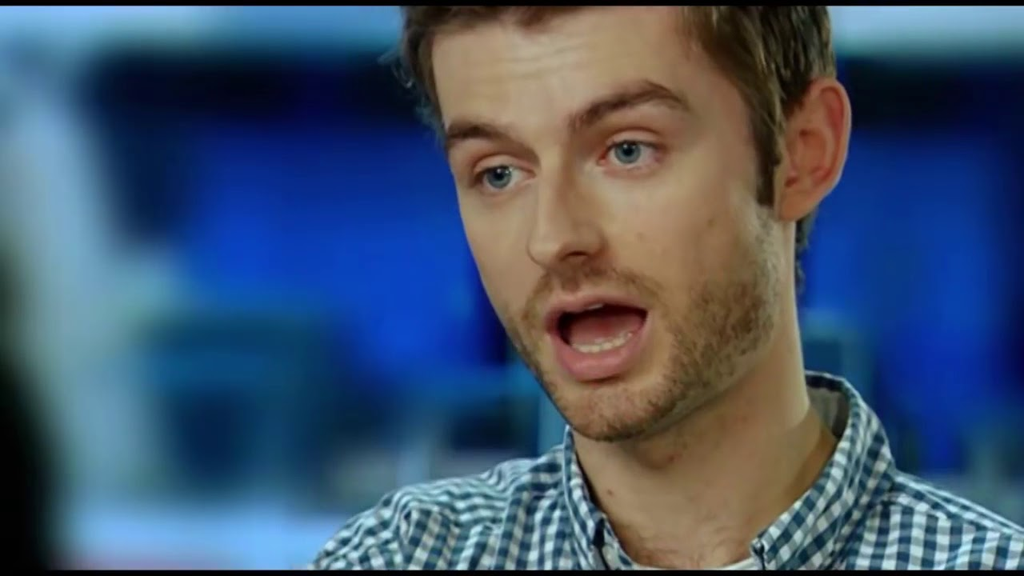
Car hiring form 🚗
What’s his surname?
2. What’s his first name?
3. What’s his nationality?
4. What’s his address?
5. What’s his post code?
6. What’s his mobile phone number?
7. What’s his home phone number?
8. What’s his email address?
 | video 🎦
Whatling
Paul
British
29 Elmore road Bristol
BS136QT
07969831016
01174806544
paul99@webmail.com

Slide 11
Vocabulary: World 🌎
Nationality
Language
Country
Culture
Flag

Slide 12
Matching exercise 🤔
A. Flag | 1. The way of life, especially the general customs and beliefs, of a particular group of people at a particular time.
B. Country | 2. An area of land that has its own government, army, etc.
C. Nationality | 3. A system of communication consisting of sounds, words, and grammar.
D. Culture | 4. A piece of cloth, usually rectangular and attached to a pole at one edge, that has a pattern that shows it represents a country.
E. Language | 5. The official right to belong to a particular country.

Slide 13
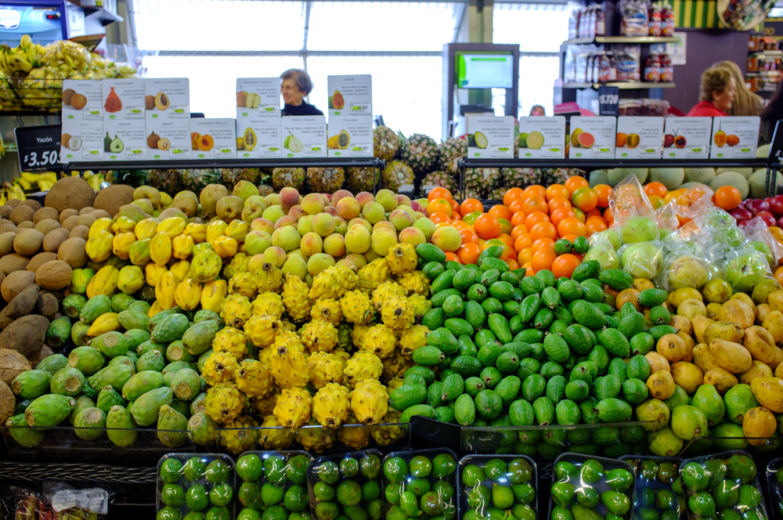
Countries, nationalities and languages 🗺️🌐㊙️
Spanish
Argentina
Belgium
Colombia
Denmark
Egypt
Argentinian
Belgian
French and German
Colombian
Spanish
Danish
Danish
Egyptian
Arabic
Colombian fruits 🥥🍍
Some fruits are exotic in Colombia such as: Golden berry, Passion fruit, Mangosteen, Borojo, Gulupa, Dragon fruit, etc.

Slide 14
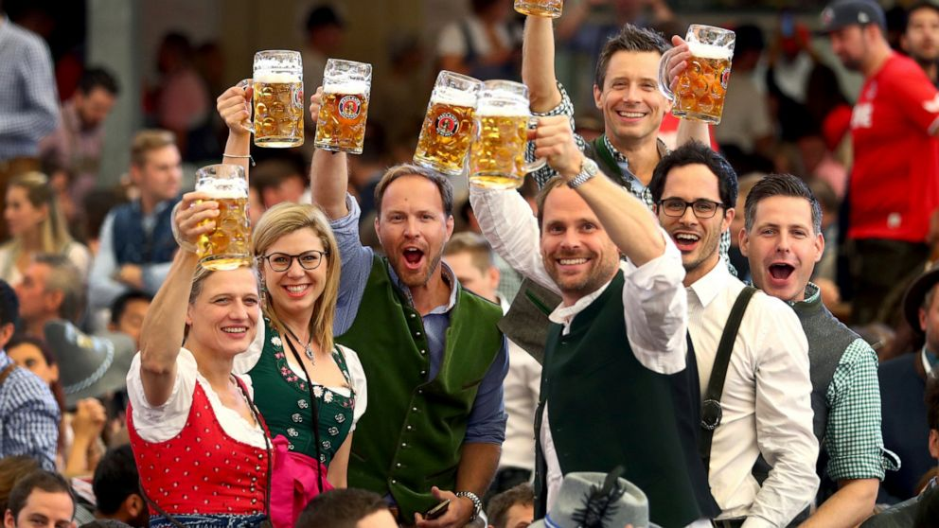
Countries, nationalities and languages 🗺️🌐㊙️
Finland
Germany
Holland
Ireland
Jamaica
Finnish
Finnish
German
German
Dutch
Dutch
Irish
English
Jamaican
English
Oktoberfest 🍻
It is held annually in Munich, Bavaria, Germany. It is a 16 to 18 day folk festival running from mid- or late September to the first Sunday in October, with more than six million people from around the world attending the event every year.
video 🎦

Slide 15
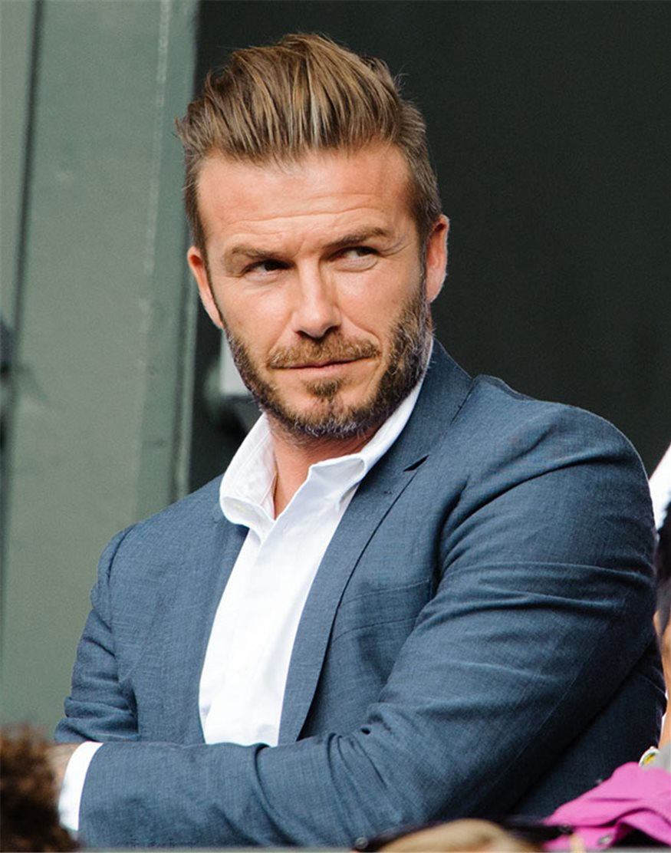
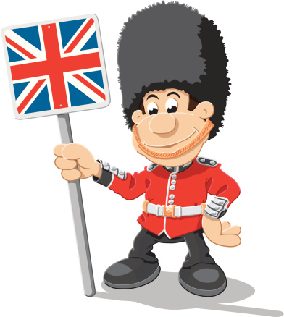

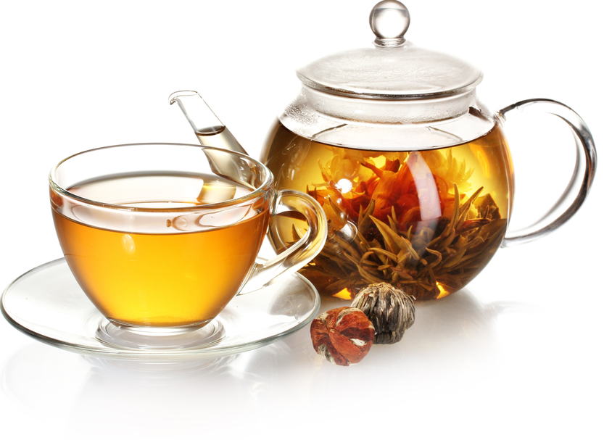

Survey 🗣️
Questions | David Beckham
1. Where is he from?
2. What’s his nationality?
3. What colours are on your flag?
4. What’s typical in their culture?
5. What language does he speak?
 | Game 🎮
He’s from England.
He’s English.
It’s red and white.
They drink tea in the afternoon.
He speaks English.

Slide 16
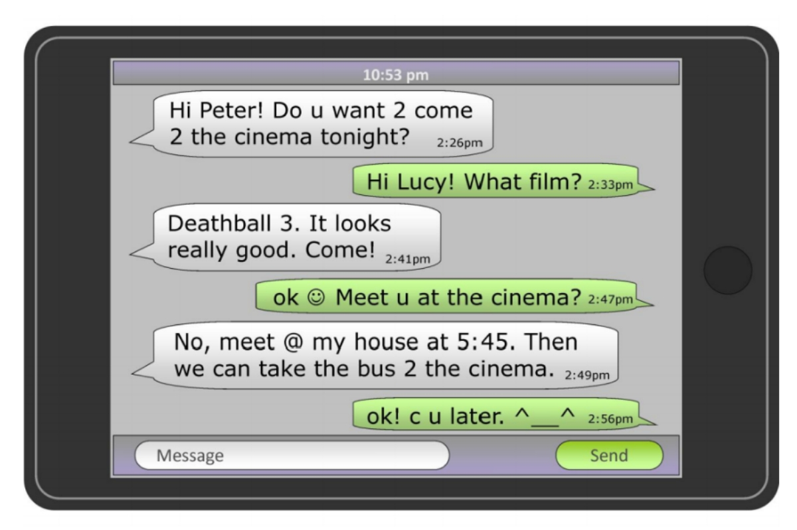
Reading: On the phone📱

Slide 17
Tips! 👍
Listening
Vocabulary
https://play.google.com/store/apps/details?id=com.ubl.spellmaster
https://es.lyricstraining.com/

